Slide 1
K Map Rules and Representation

Slide 2
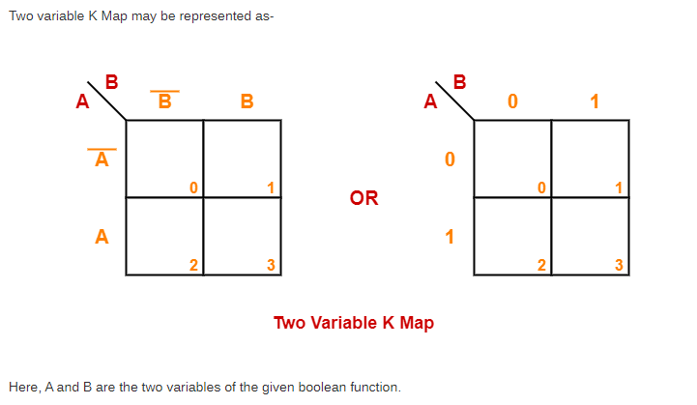
Two Variable K Map-

Slide 3
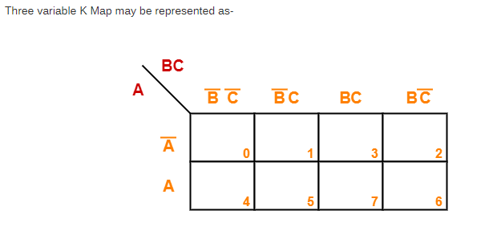
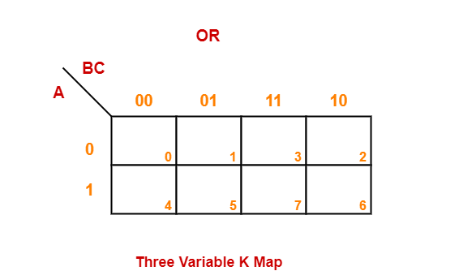

Slide 4
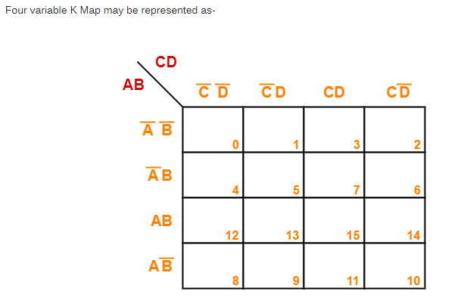

Slide 5
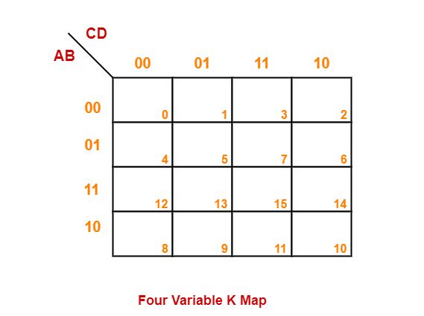

Slide 6
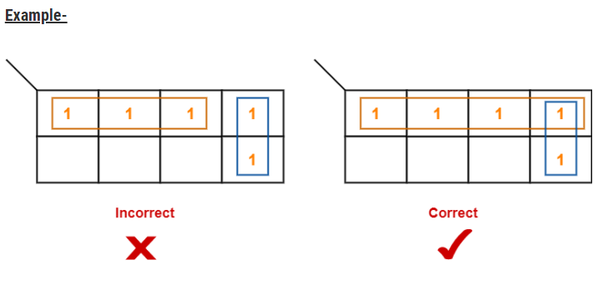
Karnaugh Map Simplification Rules-

Slide 7
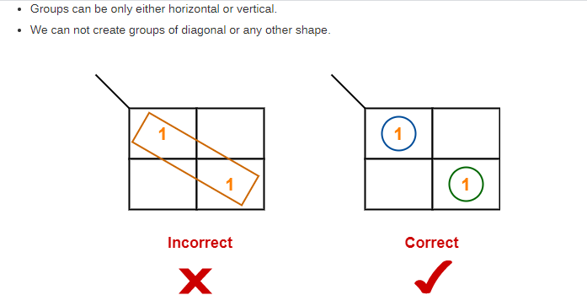

Slide 8
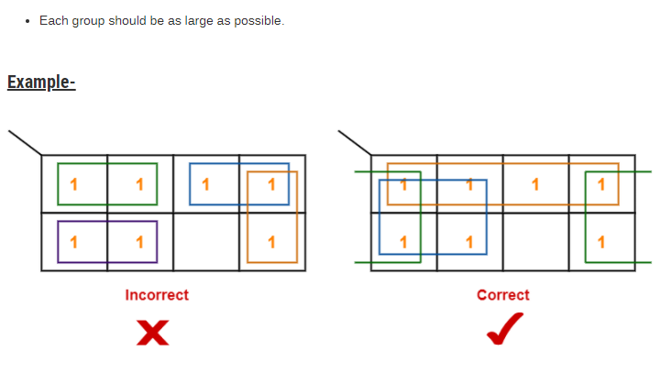

Slide 9
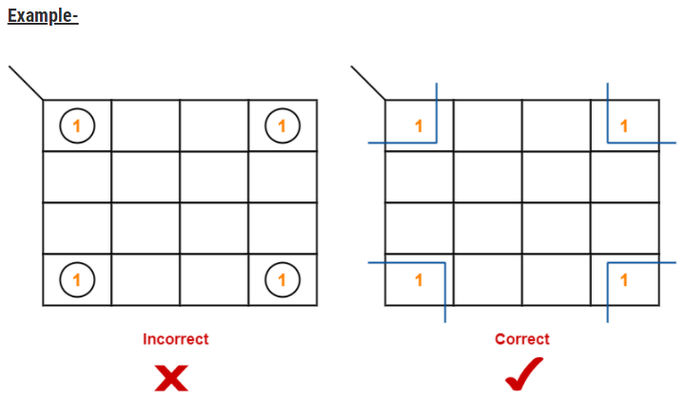

Slide 10
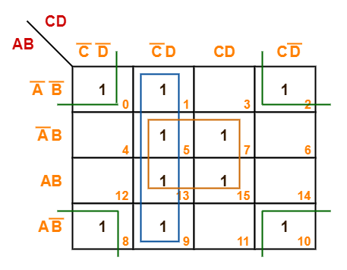
Problems and Solutions
F(A, B, C, D) = Σm(0, 1, 2, 5, 7, 8, 9, 10, 13, 15)
Answer = F(A, B, C, D) = BD + C’D + B’D’

Slide 11
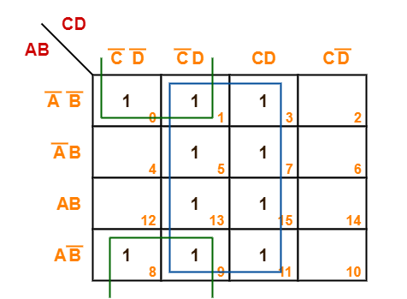
F(A, B, C, D) = Σm(0, 1, 3, 5, 7, 8, 9, 11, 13, 15)

Slide 12
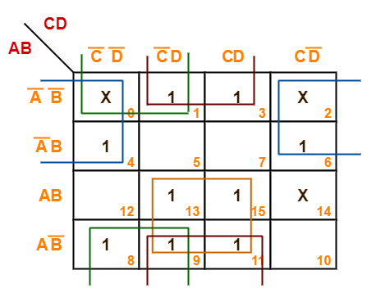

F(A, B, C, D) = Σm(1, 3, 4, 6, 8, 9, 11, 13, 15) + Σd(0, 2, 14)

Slide 13
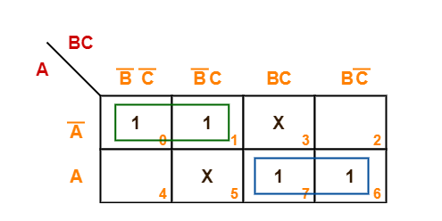

F(A, B, C) = Σm(0, 1, 6, 7) + Σd(3, 5)

Slide 14
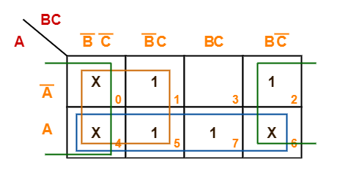

F(A, B, C) = Σm(1, 2, 5, 7) + Σd(0, 4, 6)

Slide 15
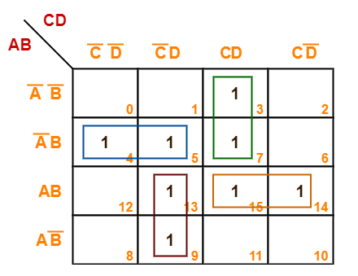

F(A, B, C, D) = Σm(3, 4, 5, 7, 9, 13, 14, 15)

Slide 16
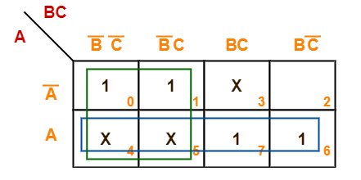

F(A, B, C) = Σm(0, 1, 6, 7) + Σd(3, 4, 5)

Slide 17
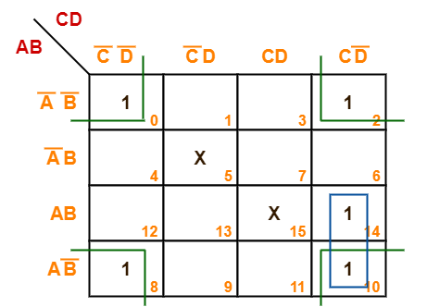

F(A, B, C, D) = Σm(0, 2, 8, 10, 14) + Σd(5, 15)

Slide 18
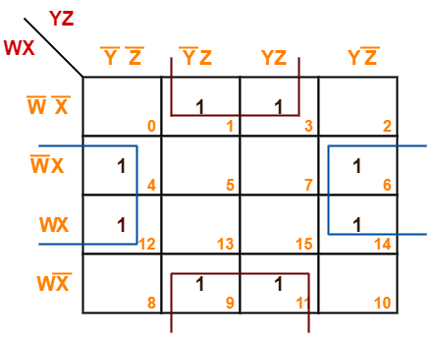

F(W, X, Y, Z) = Σm(1, 3, 4, 6, 9, 11, 12, 14)

